Slide 1
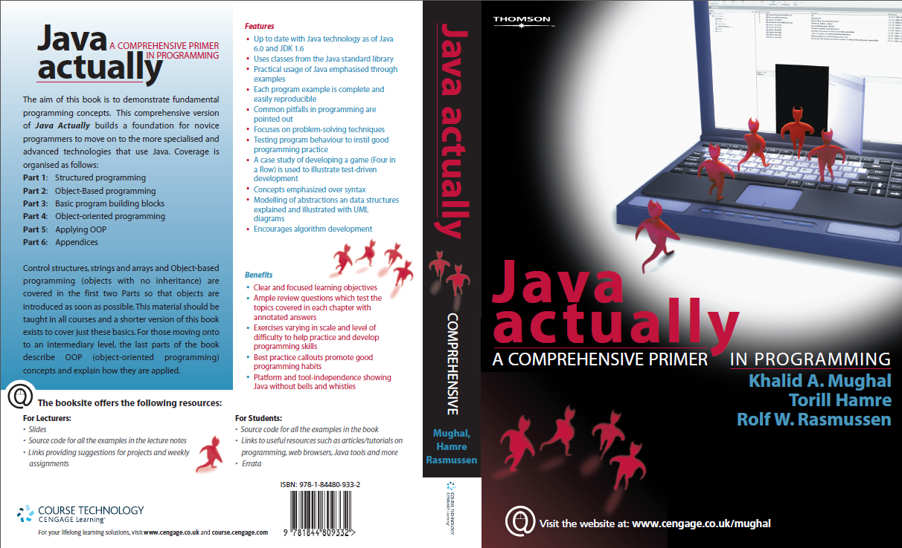
Java Actually
http://www.amazon.com/Java-Actually-First-Course-Programming/dp/1844804186

Slide 2
What We have Covered
Java Basics, How Java Functions
Working with Eclipse IDE
Code Conventions and Documentation
Java Data Types, Variables, Functions and Access Modifiers
Java Statements
Arrays, Searching and Sorting in Arrays
OOP Concepts, OOP in Java, Classes, Objects and Communication
Built-in Classes (like String)
Generics, Collections and Dynamic Data Types
Threads and Synchronization

Slide 3
What’s Next?
Java Frameworks
Mobile
Web
Code Automation
Databases
Management
SQL
Maintenance
Versioning
Ticketing
More IDEs

Slide 4
What We Expect from You
Learn

Slide 5
What We Expect from You
Learn
Adapt

Slide 6
What We Expect from You
Learn
Adapt
Share

Slide 7
What We Expect from You
Learn
Adapt
Share
Team Work

Slide 8
What We Expect from You
Learn
Adapt
Share
Team Work
Conform to Standards
If you don't Like a Rule. Just Follow it. Reach on the Top and Change the Rule – [Adolf Hitler]

Slide 9
What We Expect from You
Learn
Adapt
Share
Team Work
Conform to Standards
If you don't Like a Rule. Just Follow it. Reach on the Top and Change the Rule – [Adolf Hitler]
Manage

Slide 10
What We Expect from You
Learn
Adapt
Share
Team Work
Conform to Standards
If you don't Like a Rule. Just Follow it. Reach on the Top and Change the Rule – [Adolf Hitler]
Manage
Lead

Slide 11
What We Expect from You
Learn
Adapt
Share
Team Work
Conform to Standards
If you don't Like a Rule. Just Follow it. Reach on the Top and Change the Rule – [Adolf Hitler]
Manage
Lead
Make a difference…

Slide 12
References
Java Actually http://www.amazon.com/Java-Actually-First-Course-Programming/dp/1844804186
Lectures from Dr. Khalid Mughal http://www.ii.uib.no/~khalid/jac
Online tutorial from Oracle Java http://docs.oracle.com/javase/tutorial/java
JDK http://www.oracle.com/technetwork/java/javase/downloads/index.html
Eclipse http://www.eclipse.org/downloads/packages/eclipse-ide-java-ee-developers/keplersr1

Slide 13
THANK YOU

